Slide 1

Department of Electronics and Communication Engineering VISHNU INSTITUTE OF TECHNOLOGY(A),BHIMAVARAM
Automatic Pet Feeding System Using Google Assistant and NODE MCU
TEAM
K.V.SUBBARAMIREDDY -19PA1A0484
J.RAMANJANEYA REDDY-19PA1A0466
N.JESSICA -19PA1A04B5
N.UDAY SANKAR -19PA1A04B4
K.ROHIT -20PA5A0415
Under the Supervision of
ABDUL RAHAMAN SHAIK
ASSOCIATE PROFESSOR,ECE Department

Slide 2
CONTENTS
Introduction
Components
Block Diagram
Circuit Diagram
Working of the project
Results and Discussion
Hardware Implementation
Conclusion
References
Appendix

Slide 3
INTRODUCTION
If you have a pet in your home and you don’t have time to feed it or when you are away from home then you definitely need some kind of machine to do this job.
We are proposing an IOT Pet Feeder machine which is simple, efficient and cost effective.
Using this machine you can feed your Pet with the help of Google Assistant from​ anywhere in the world. ​
You just have to say "Okay Google. Feed my pet" and rest of the things​ will be done by this machine.
You can also set a specific time using Google Assistant to feed your pet, for example Say "Okay GOOGLE FEED MY PET AT 10:00AM”​

Slide 4
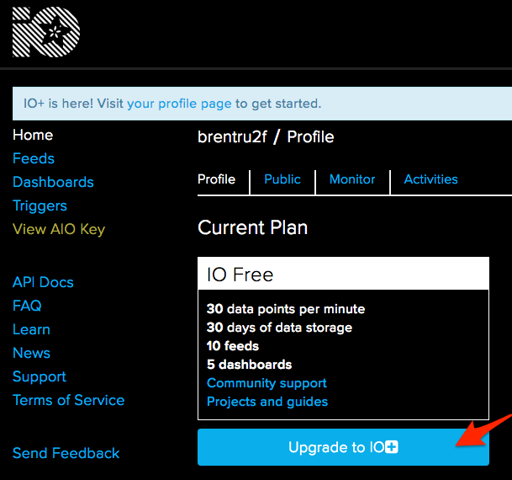
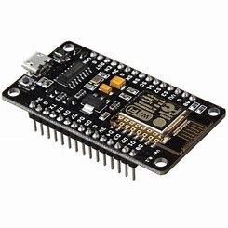
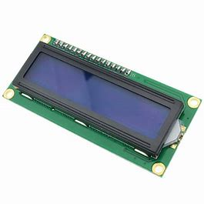
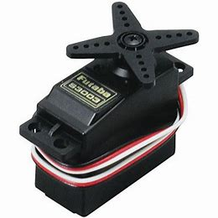
COMPONENTS
Node MCU ESP8266
Servo Motor
LCD Display
Container
Bowl
Adafruit io
IFTTT

Slide 5
BLOCK DIAGRAM
FEEDING CONTAINER
BOWL
SERVO MOTOR
LCD DISPLAY
NODE MCU

Slide 6
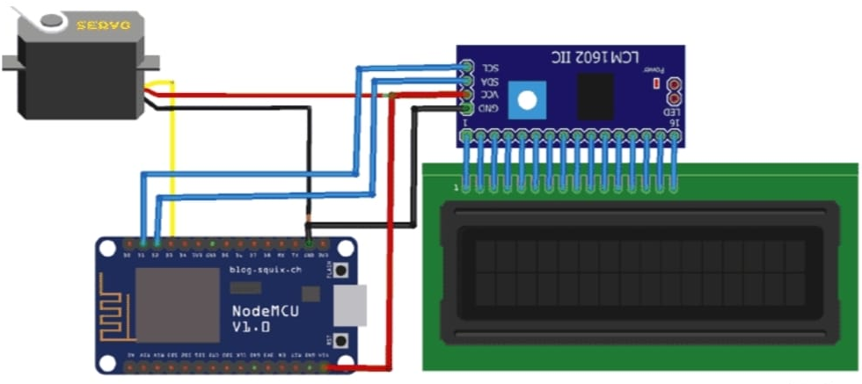
CIRCUIT DIAGRAM

Slide 7
WORKING OF THE PROJECT
In this project, we are using a Node MCU ESP8266 as the main controller, a Servo motor to open and close feeding Container, a bowl to dispense the food , and a 16*2 LCD to display to see the update and time of feeding. We will get the time from NTP servers.
In the feeding container food is stored by the feeder which is attached to the stand at the height of 200cm away from the dispense bowl.
When feed command is received by the NODE MCU, it activates the Servo motor which is used to close and open the feeding container to dispense the food in the bowl.
The current time and feed time will be displayed on the 16*2 LCD.
Here we use two platforms, Adafruit IO is a "open data platform that allows you to aggregate, visualize, and analyze live data on the cloud".

Slide 8
IFTTT aka ‘If This Then That’ a free web-based service to create chains of simple conditional statements, called applets to enable the google assistant. We have to create an applet in which we will integrate the Google Assistant with Adafruit IO
To feed the pet, we have to Say "Okay Google. Feed my pet" to the Google Assistant. Google Assistant will recognize the phrase and respond with "Ok ,Task is complete."
Node MCU automatically sends the triggers to the Servomotor which opens the lid of the food container and dispenses the food into bowl and closes the lid after a specific interval of time.
We can also program the system to dispense food at a specific time using commands like “ Ok Google , feed my pet at 10 am “

Slide 9
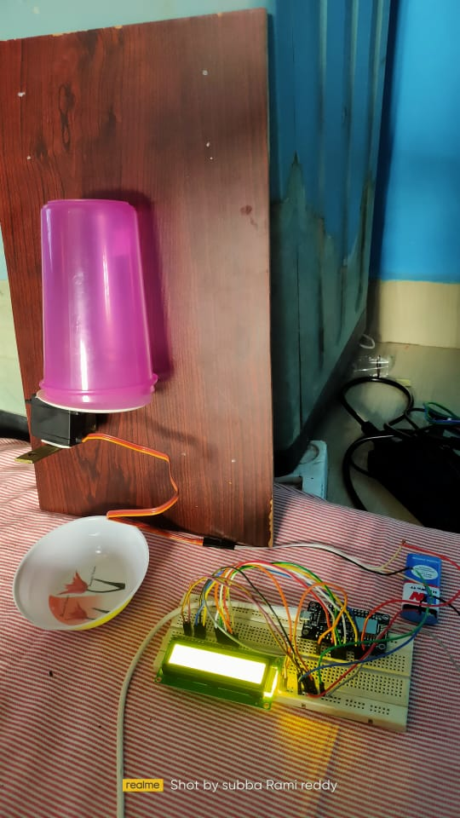
RESULTS AND DISCUSSION
The following picture shows the complete setup.

Slide 10
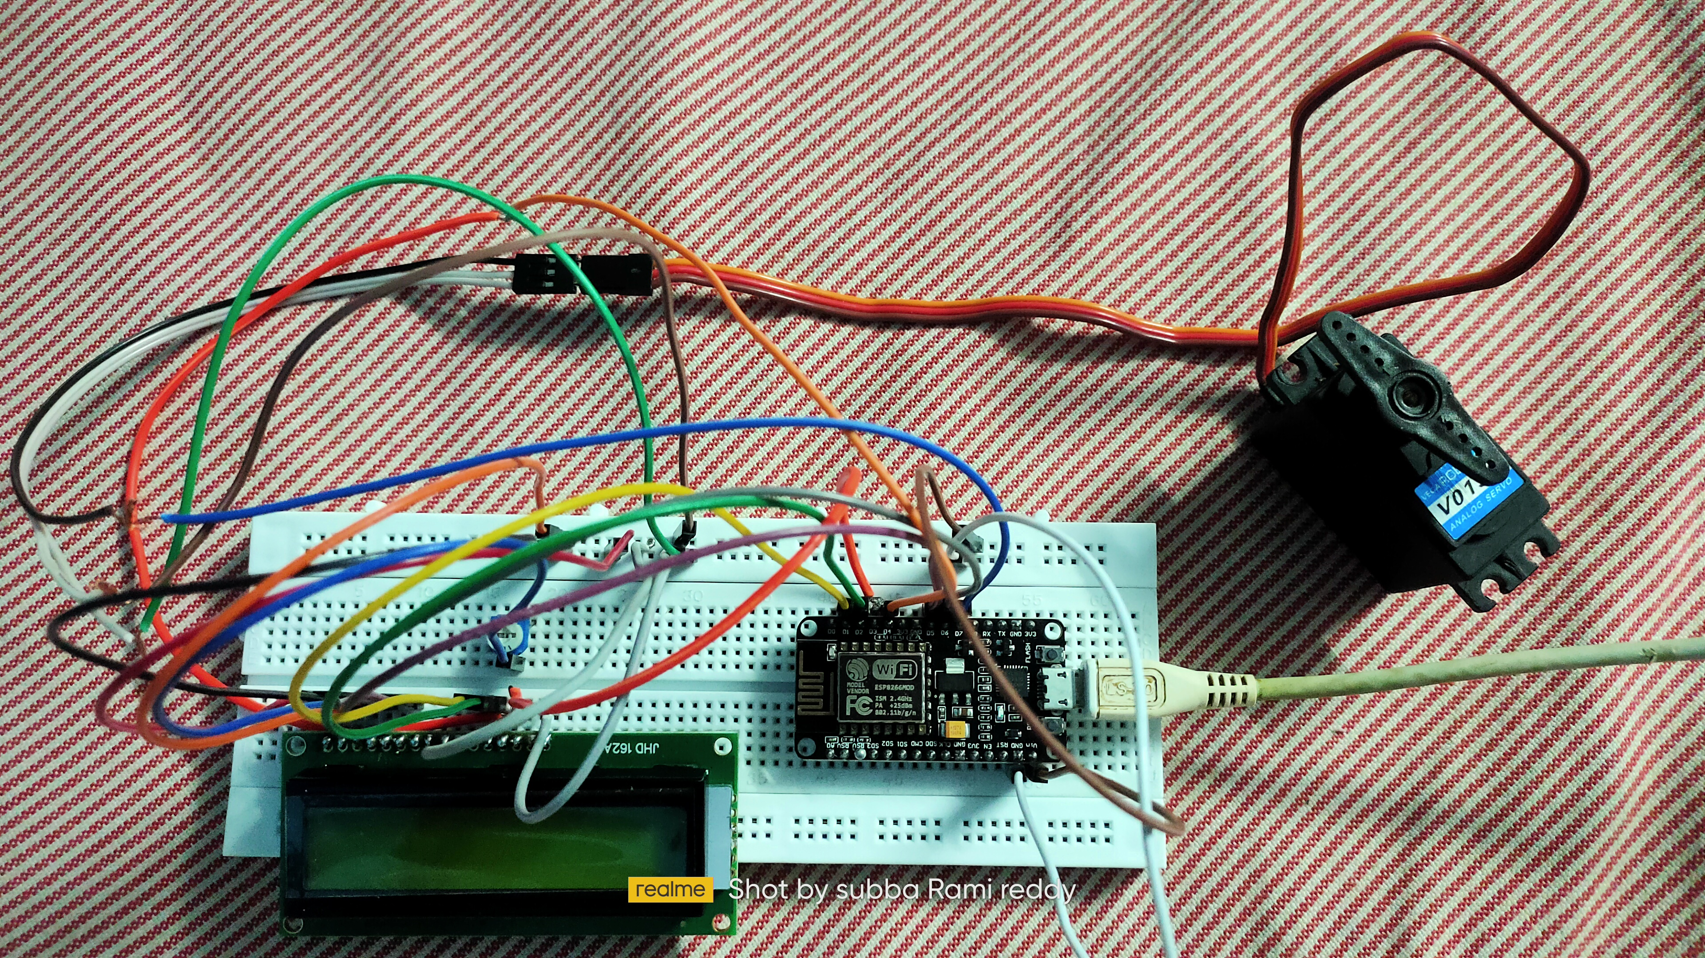
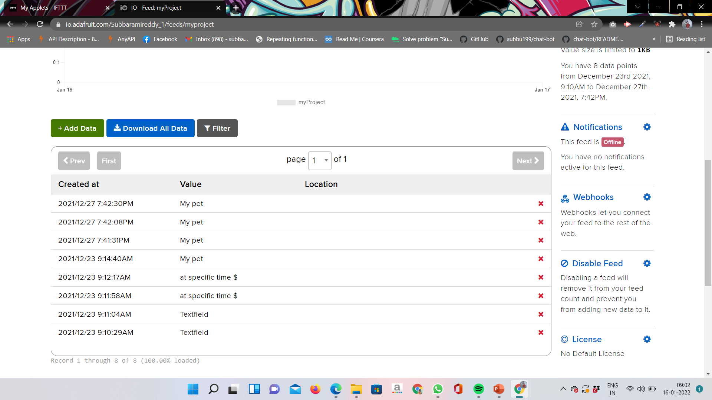
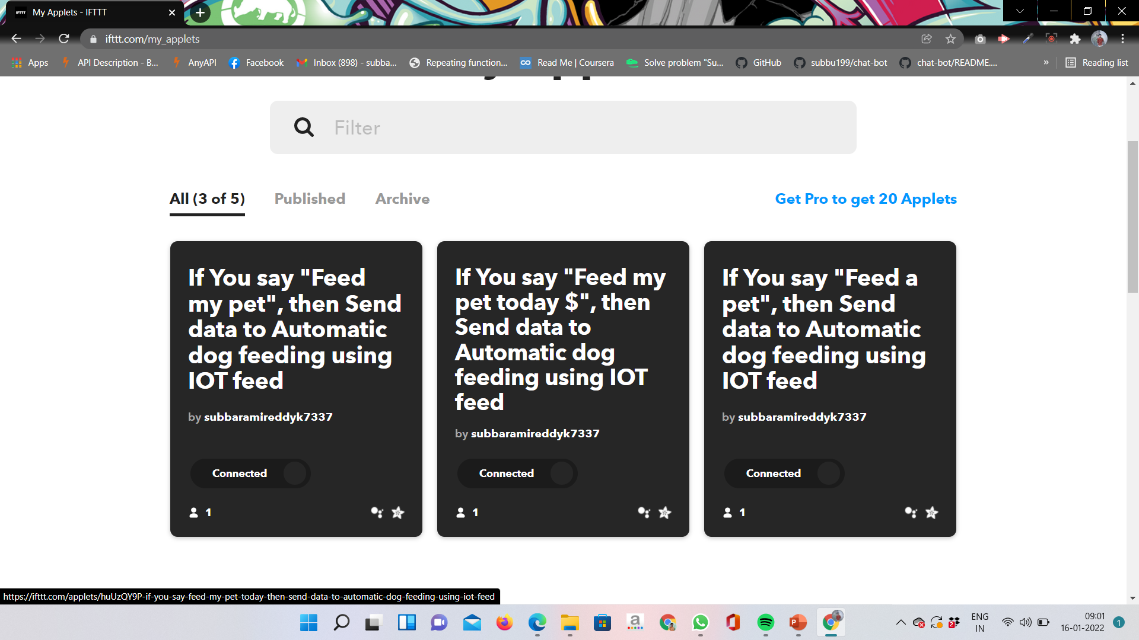
HARDWARE SIMULATION

Slide 11
CONCLUSION
Finally we conclude that , the implementation of automatic pet feeding system using Node MCU and google assistant is safe and secure way of feeding pets.
The system is completely automatic and provides the food to the pet on time without any delay.
We can track the data stored in the cloud which will be helpful to keep a record of pet health and its apetite.

Slide 12
REFERENCES
Hari N. Khatavkar, Rahul S.Kini, Suyash K.pandey,Vaibhav V. Gijare Wayne, “ Intelligent Food Dispenser (Ifd)”, IOSR Journal of Engineering (IOSRJEN) , pp 65-70, 2019.
Sowmiyalaxmi, Rajsekaran, ” Automatic Pet Feeding and Monitoring System” , vol. 10 No. 14, International journal of ChemTech, Aug 2017.
Manoj M, “Automatic pet feeder” , International journal of advances in science engineering and technology, vol. 3, issue 3 , sept-15.
Saurabh A. yadav, Sneha S. kulkarni, Ashwini S. jadhav, Prof. Akshay R. jain, “IOT BASED PET FEEDER SYSTEM”, IJARIIE-ISSN(O)-2395-4396, Vol-4 Issue-2 2018.
.D. Munteanu and R. Ionel, "Voice-Controlled Smart Assitive Device for Visually ​Impaired Individuals", 2016 12th International Symposium on Electronics and ​Telecommunications IESTC 2016, pp. 186-189​.

Slide 13
Appendix

Slide 14


